Slide 1
Project 0 Bios 6623
Bridget Balkaran
9/13/17

Slide 2
Research Question
This study uses different concentrations of the treatment dental gel and aims to investigate if the different gel concentrations are associated with decreased values of whole mouth average attachment loss and whole mouth average pocket depth. These differences in gel concentration included a no treatment control group, a placebo control group (a gel with no concentration of treatment), a low concentration of treatment, a medium concentration of treatment, and a high concentration of treatment.

Slide 3
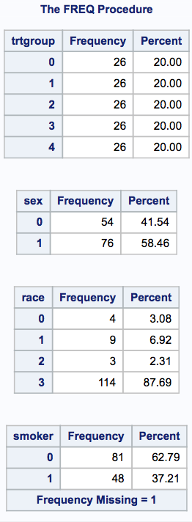
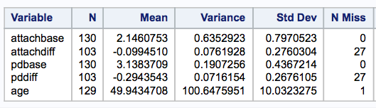
Summary of Data
Code | Treatment | Sex | Race | Smoker
0 | No treatment | Male | Native American | No
1 | Placebo (blank gel) | Female | African American | Yes
2 | Low concentration |  | Asian
3 | Medium concentration |  | White
4 | High concentration
Table 2. Summary of Continuous Variables
There were 27 subjects lost to follow-up. Year one information on these individuals was unknown and they were left out of analyses.
Frequencies of race category are not even. Small sample of non-white individuals may not have a significant effect on results.

Slide 4
Data Analysis Plan
Clean Data
Summary Statistics
Crude models - Check Assumptions
1) attachment loss difference 2) pocket depth loss difference
Correlation Analysis – to see if any covariates significantly correlated with outcome
Model Selection - backwards elimination holding treatments groups and baseline in models
Pairwise comparisons (if groups are significant in model) - ANOVA or T-test

Slide 5
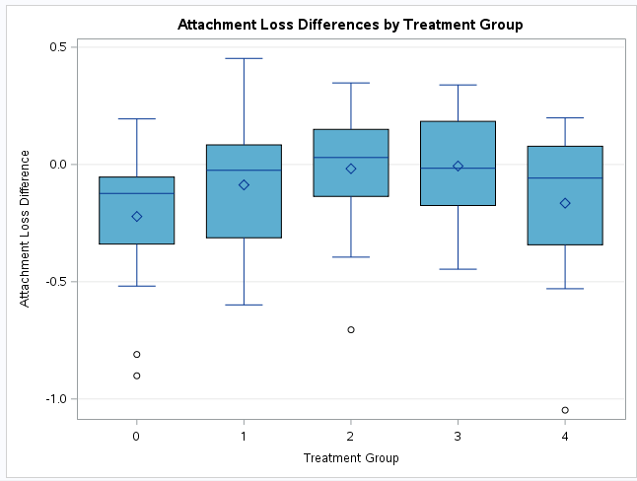
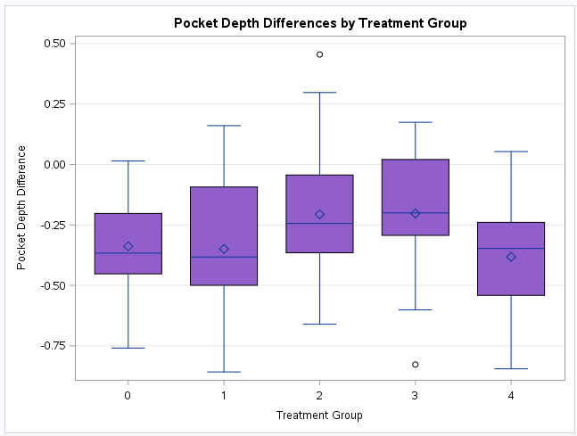
Attachment Loss Difference and Pocket Depth Difference
Figure 1. Attachment Loss Difference and Treatment Group
Figure 2. Pocket Depth Difference and Treatment Group

Slide 6
Limitations
Loss to follow-up - loss of power
Compliance – could result in bias
Analysis with Intent to Treat
Small sample
Further investigation in to potential trend for high concentration
http://www.glasbergen.com/wp-content/gallery/dentist-cartoons/toon-3478.gif

